Slide 1
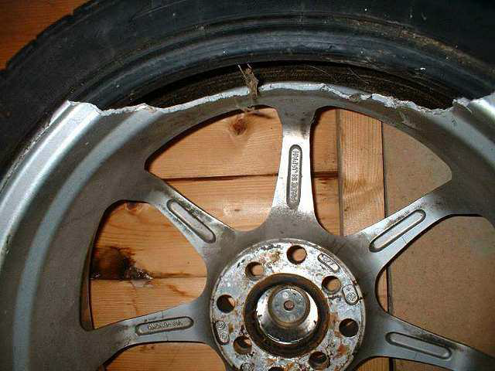
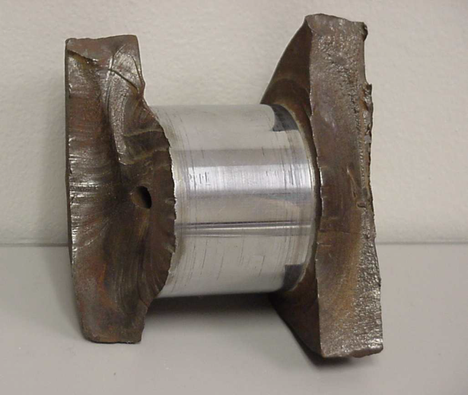
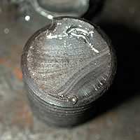
Fatigue
Fatigue is a failure which occur when metal is subjected to dynamic and fluctuating
stresses and will fail at a stress much lower than its tensile strength.
Fatigue failures occur without any plastic deformation (without any obvious warning).
It is believed that more than 90 % of all mechanical failures can be attributed to fatigue.
Fatigue failure occurs at the outer rim of the wheel
Failure of crankshaft
Fatigue failure of a bolt

Slide 2
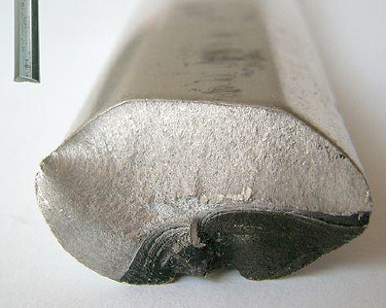
Fatigue fracture surface
Fatigue surface appears as a smooth region, showing beach mark or origin of fatigue crack.
Fatigue failure in an Aluminium bicycle crank. Dark area of striations: slow crack growth. Bright granular area: sudden fracture
Failure stages (the life of a fatigue crack)

Slide 3
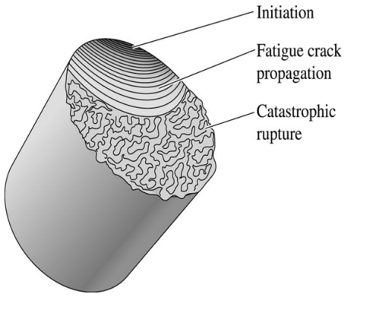
Failure stages are :
Crack initiation
Crack propagation
Final fracture.
The crack propagates from an initiating point such as a sharp corner, indent, flaw or other stress raiser.
1➢ Crack initiation (in notched specimens this stage may be absent). This occurs mostly at surfaces or sometimes at internal interfaces. Crack initiation may take place within about 10% of the total life of the component. Crack initiation in the areas of stress concentration 2➢Crack propagation
Stage I short crack growth : growth of crack along planes of high shear stress. (something like deepening of the crack formed).
Stage II stable crack growth: in this stage the crack grows along directions of maximum tensile stress. 3➢ Final fracture (end of life): reduction in load bearing area (due to crack propagation) leads to ultimate failure.
Definitions
Fatigue life(N): it is total number of cycles are required to bring about final fracture in a specimen at a given stress.
Fatigue limit or Endurance limit (S_{e} or σ_{e}): it is stress below which a material will not fail for any number of cycles. Or is the maximum stress that a material can endure for an infinite number of cycles without breaking.

Slide 5
Stress cycles
Completely reversed cycle of stress:
Illustrates the type of fatigue loading where a member is subjected to opposite loads
alternately with a means of zero (σ_{m} = 0)
For example bending of steel wire continuously in either direction leads to alternate tensile and compressive stresses on its surface layers and failure fatigue. If the applied load changes from any magnitude in one direction to the same magnitude in the opposite direction, the loading is termed completely reversed, i.e. direction changes without changing in the magnitude
Repeated stress cycle:
Type of fatigue loading where amember is subjected to only tension but to various degrees i.e. the A spring subjected to repeated tension as in a toy would lead to fatigue failure. i.e. magnitude changes without changing in the direction
Irregular or random stress cycle:
This type of fatigue loading where a member could be subjected to irregular loads just as in the case of an aircraft wing subjected to wind loads.
i.e. both magnitude and direction change.

Slide 6
Stress cycles
Completely reversed cycle of stress (sinusoidal) ,
Repeated stress cycle
Fluctuating
Tensile stress +
Compressive stress -
Irregular or random stress cycle

Slide 7
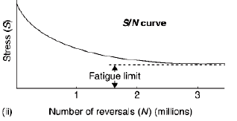
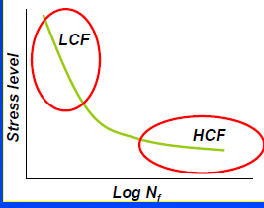
The S-N curve or Wohler curve
S-N Curve is alternating stress amplitude (σ_{a} or S_{a}) versus number of cycles (N) to failure.
Stress can be σ_{a}, σ_{max}, σ_{min,} σ_{m} , R or A should be mentioned
HCF high cycle fatigue (low strain) : fatigue failure at high numbers of cycles (N > 10⁵ ) and low loads
LCF low cycle fatigue (high strain) :
fatigue failure at low numbers of cycles N < 10⁴ or 10⁵ and high loads.
N increases with decreasing stress level
This mean σ_{m} or σ_{a} decreases with N.
Basquin equatiion
The S-N curve in the high-cycle region is sometimes described by the Basquin equation
σ_{a} = alternate stress amplitude
N= number of load reversals to failure
σ_{f} = fatigue strength.
coefficient defined by the stress intercept at 2N=1.
b= fatigue strength exponent, which varies between –
0.05 and -0.12 for most metals

Slide 8
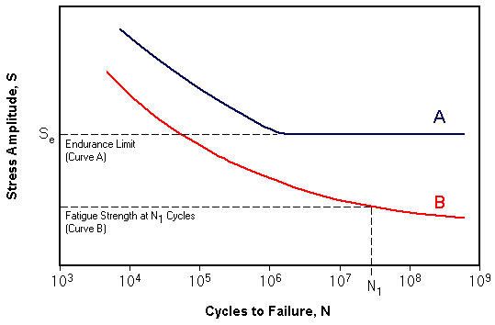
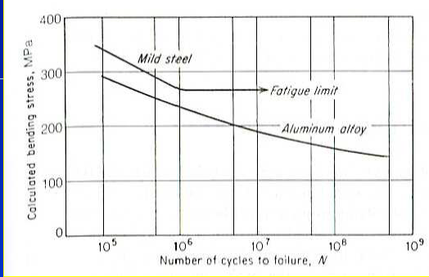
Fatigue Limit or Endurance Limit
Some materials have a fatigue limit (or endurance limit) below which the stress can be cycled infinitely. This happens with steel and titanium under the right conditions. (Curve A)
Fatigue limit or endurance limit is normally defined at 10⁷ or 10⁸ cycles. Below this limit, the material presumably can endure an infinite number of cycle before failure.
Many non-ferrous metals and alloys, such as aluminum, magnesium, and copper alloys, do not exhibit well-defined fatigue (endurance limits). The S-N curve, like Curve B will last for a certain number of cycles for a certain stress, but not “infinite”.
No. of cycles for a non ferrous material is 5x10⁸ cycles.
•
Typical fatigue curves

Slide 9
Factors Affecting Fatigue Strength
Mean Stress
Surface Finish
Residual Stresses
Environmental effects
Stress concentration
Temperature
Mean Stress effect
Note: crack propagation has been measured as a function of the stress intensity factor. stress intensity factor range K, which is a function of stress range and crack length.

Slide 10
2. Surface Finish
Normally, scratches, pits, machining marks, and so forth, influence fatigue strength by providing additional stress raisers that aid the process of crack nucleation.
Solutions:
Polishing (removes machining flaws etc.)
Surface treatments
Case hardening by Carburization or Nitriding
3-Residual Stresses For many purposes, residual stress can be considered identical to the stresses produced by an external force. Thus, the presence of a compressive residual stress at the surface of a component will effectively decrease the probability of fatigue failure.
Commercial methods introducing favourable compressive stress are : rolling, polishing, Quenching or surface treatments
4- Environmental effects
Thermal Fatigue. Thermal cycling causes expansion and contraction, hence thermal stress.
Solutions:
change design
use materials with low thermal expansion coefficients.
Corrosion fatigue. Chemical reactions induce pits which act as act as notches and stress raisers and lead to reduce the fatigue strength. Corrosion also accelerates the rate of fatigue crack propagation.
Solutions:
decrease corrosiveness of medium
add protective surface coating
add residual compressive stresses

Slide 11
5- Stress concentrations
Stress concentrations reduce the fatigue strength by a factor K, determined by the geometry of the notch.
Should avoid stress raisers from machining and fabrication processes.
Avoid inclusions which lead to stress concentration and results in reducing fatigue strength
• The effect of stress raiser or notch on fatigue strength can be determined by comparing the S-N curve of notched and unnotched specimens.
6- temperature
Extreme high or low temperatures can decrease fatigue strength.

